Slide 1
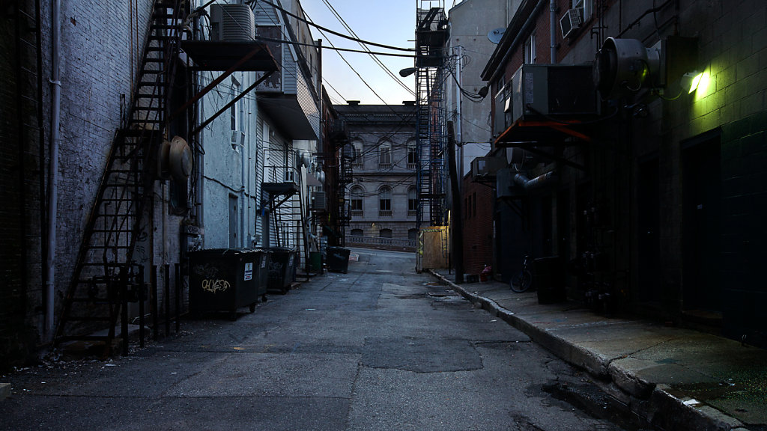

Team 4

Slide 2
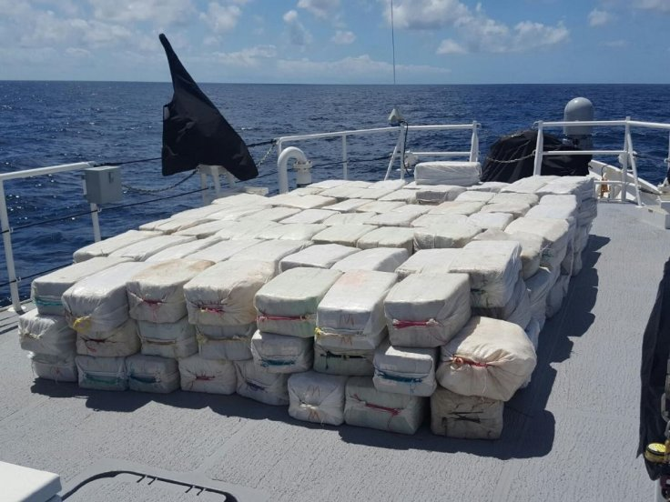
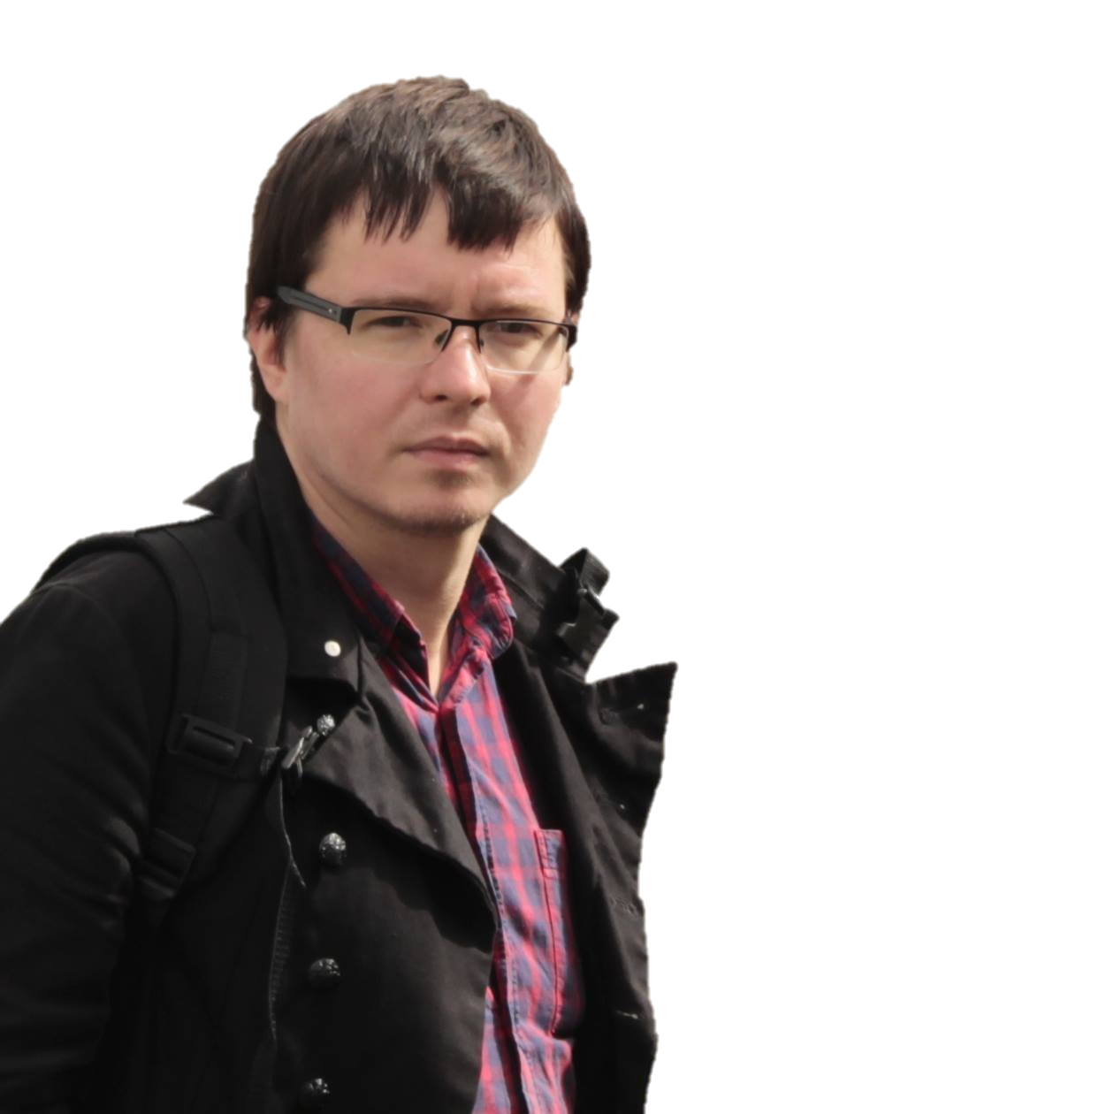

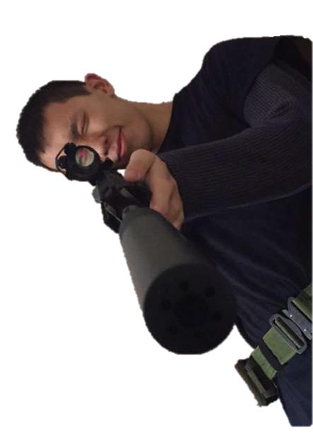


CSI: Cardiff

Slide 3
Team Roles
Bartosz – Game Development
Janrey – Game Development
Luke – Game Development
Nour – Story Development
Stanislav – Lead Story Developer
Suraj – Story Development and Dialogue
Miltos – Character Development
Joe – Writing Up

Slide 4
What is our Game?
A text-based detective RPG set in Cardiff
You play as a crime scene investigator, assigned with the task of solving a hit and run case on a fellow detective
Using the evidence you have collected, you must try to convict the correct perpetrator without any deaths occurring
Notes:
Suraj
…

Slide 5
Features of the Game
Through the game you meet multiple suspicious characters, all of whom have their own individual personalities
Game is not linear – the decisions you make alter the pathway of the game
Timed events
Inventory
Notes:
Stanislav
Each character has their own emotional responses that were scripted – to make the user feel part of the game
Some decisions will allow you to continue and make more – if you make a wrong one the game will end
Limited time for the user to react to – making it realistic – if the user does not react quick enough it sends you on a different path

Slide 6
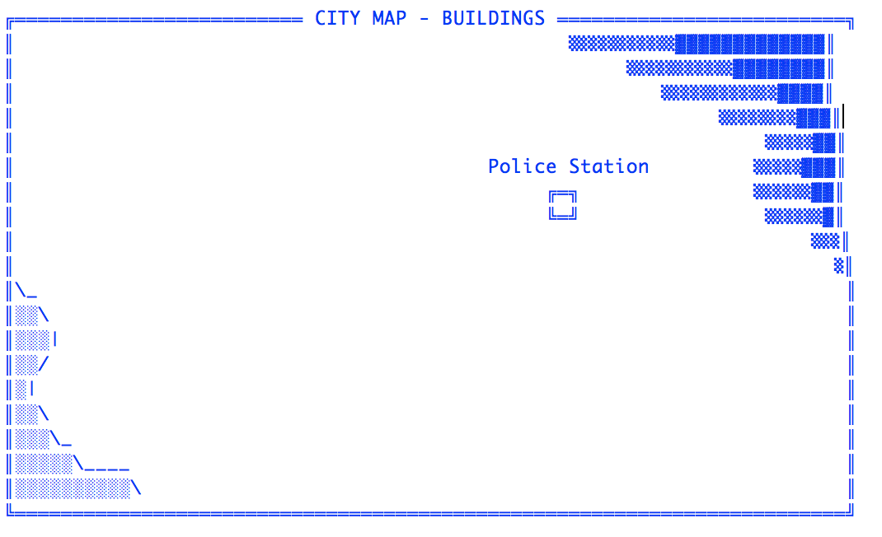
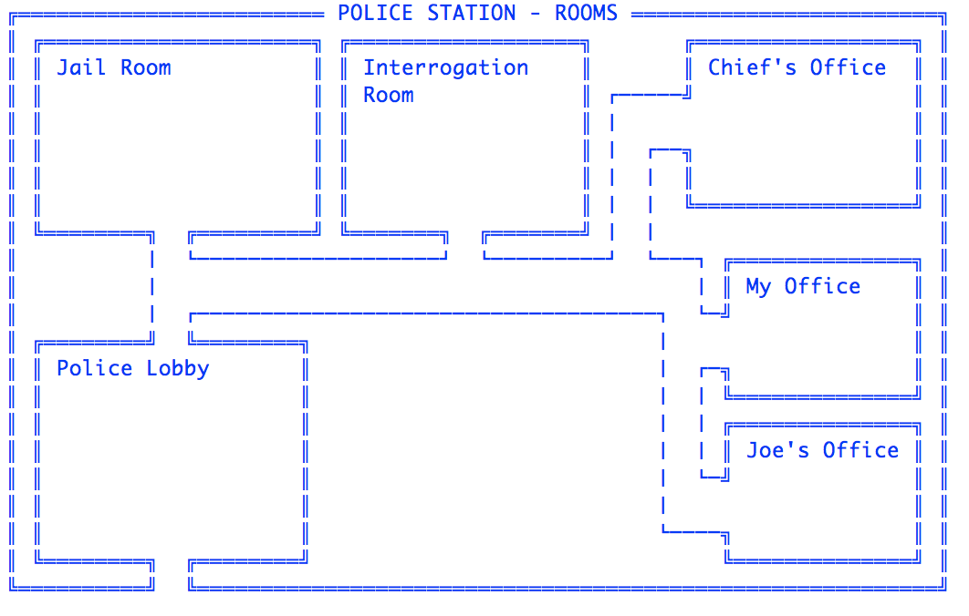
Map Feature
Full area map
Free roam – you can explore every building unlocked
Map updates once you unlock new buildings
Notes:
Bartosz
ASCII Map accurately displays the map
Buildings become unlocked as you progress – once unlocked it allows you to enter them whenever
^^^ - these are reflected in the map

Slide 7
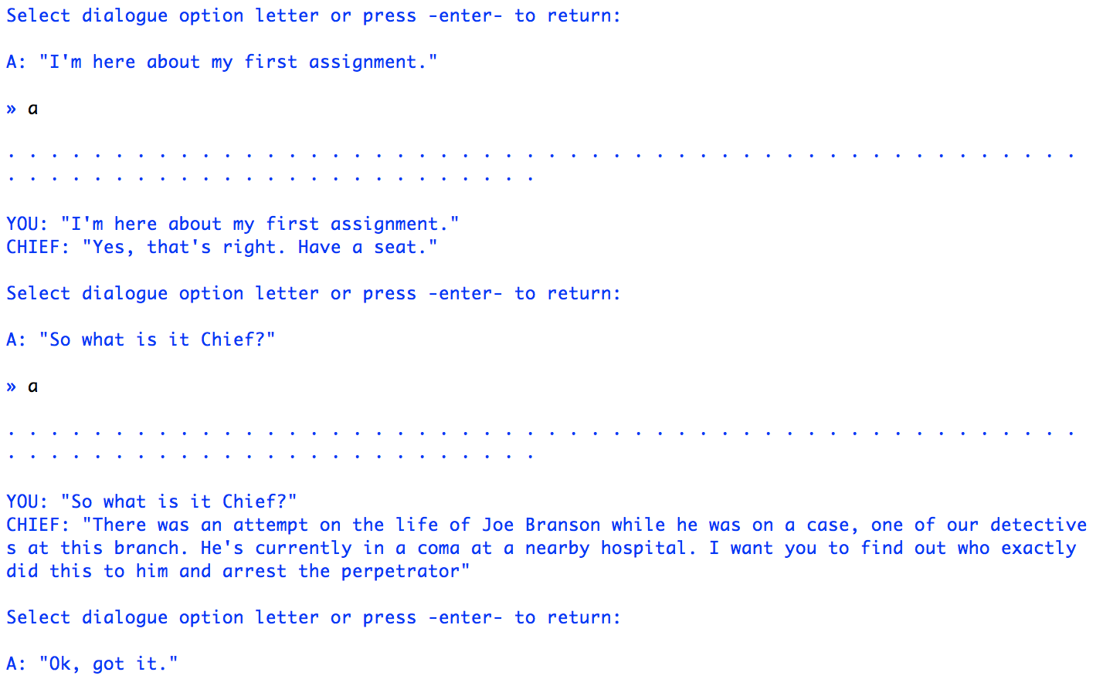
Interactive Dialogue Feature
Each character has their own unique personality
Your choices can affect the storyline
Your dialogue choices open up new game path ways
Notes:
Miltos
Script made for each character giving them each a unique personality
So depending on what you pick it will send you down a different path – only one path is correct and will complete the game
Picking a bad choice may lead to a game over but a good one may lead to other choices

Slide 8
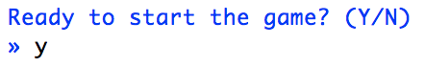
Save and Load Feature
This allows you to continue from a previous save
For example, If you continue along the wrong game path - you can return to a previous save and continue
Notes:
Luke
…

Slide 9
How is it Original?
Map updates once you unlock new buildings
Emotion based interactive NPC dialogue
Original story
Timed Events
Decisions made in game will effect future DLC content
Notes:
Joe
The map never stays the same and changes as the story carry's on – when you discover a new place it will appear in the map
Each NPC had a script written for them to make it more realistic and feel like you are playing as the character
Story was created by us
User will be given a certain amount of time to pick the correct option or it will end up in them failing the game
Swansea DLC

Slide 10
Game Demo

Slide 11
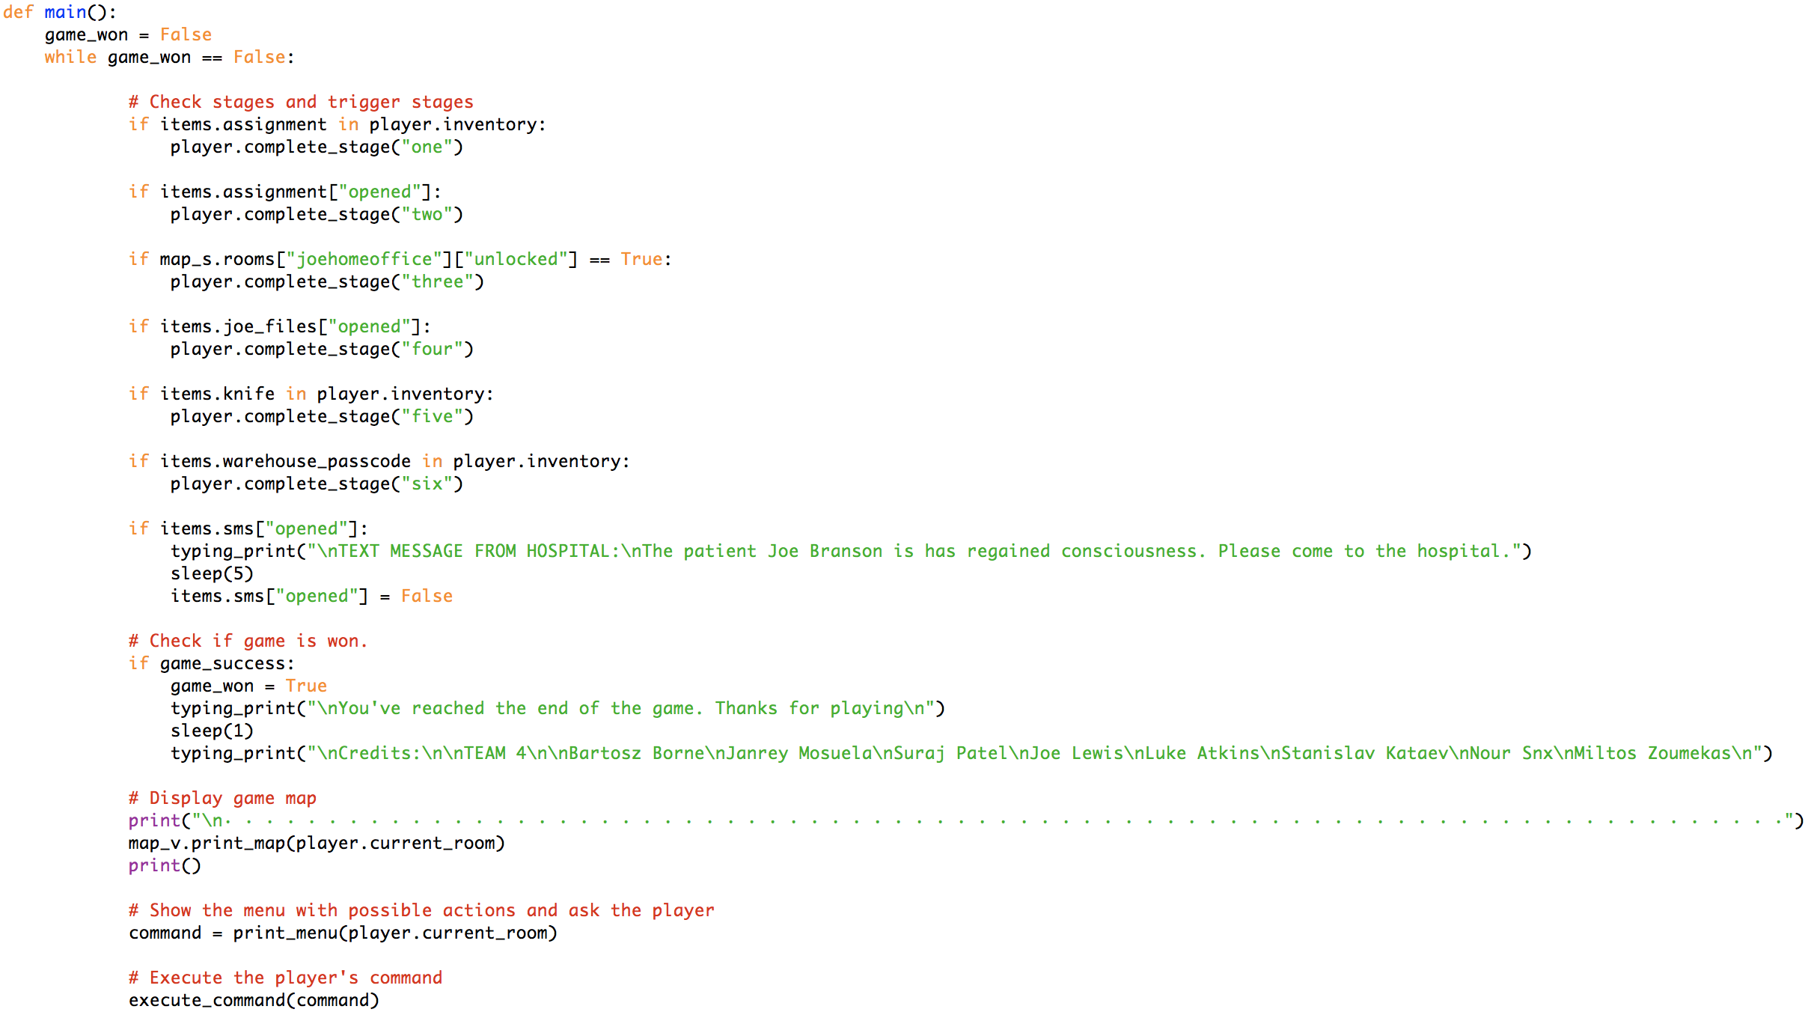
Design
Notes:
Bartosz

Slide 12
Why should you Buy this Game?
There are multiple paths you can take and only one is the correct
It has a unique storyline including interactions with other NPC’s that include emotions
Runs on windows and mac
Unique compelling story line
Emotional ending
Notes:
Takes time to complete the game – every time you restart you may come across something different– takes time to find correct ending so you would get a lot of enjoyment out of it
Feel part of the game – makes you addicted to the game – complicated to value for money
Billions of computers run the game so you are guaranteed to be able to play the game if you get it

Slide 13
Questions?
Notes:
…

Slide 14

SWANSEA DLC
Early BETA access*
New maps
New weapons
New players
Online multiplayer
More murders
New campaign
Online PvP
Buy for £9.99 or Game pass for £29.99 for access to ALL future award winning DLC’s**
IGN: 4/5 “Best text based game ever!”
BBC: 5/5 “Revolutionize the gaming world!”
Telegraph: 5/5 “No game even comes close to this great experience”
Times: 5/5 “Can someone make a movie based on that, already?”
*Early BETA access starts 25th December for people who have preordered
**We awarded ourselves the awards for the future DLC’s

